Slide 1
Fully Actuated Variable Compliant Robot Thumb
Chris Berry and Yasmin Bragg

Slide 2
Aim
To design a robotic thumb with the ability to display variable compliance. This will be utilising a ball joint and a hinge joint to represent the field of movements provided by the Metacarpophalangeal and Interphalangeal Joints in the human thumb. The intention is that the design could eventually be integrated into a fully robotic hand.

Slide 3
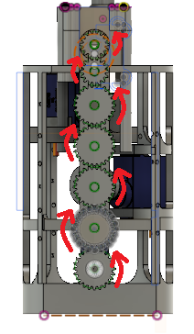
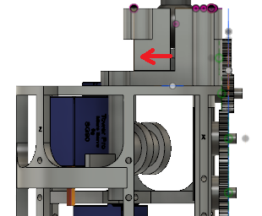
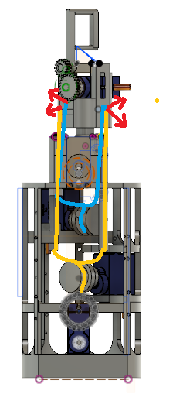
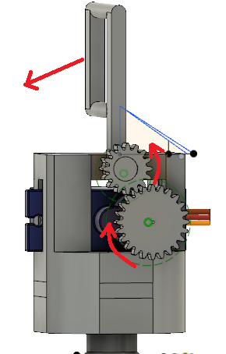
Design Concept

Slide 4
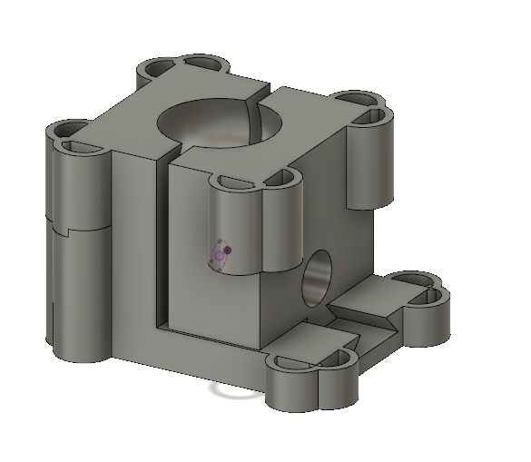
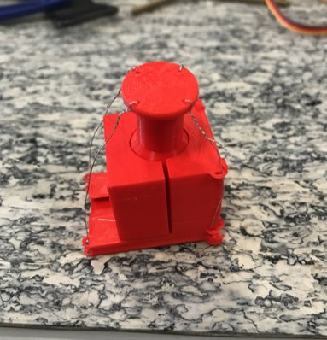
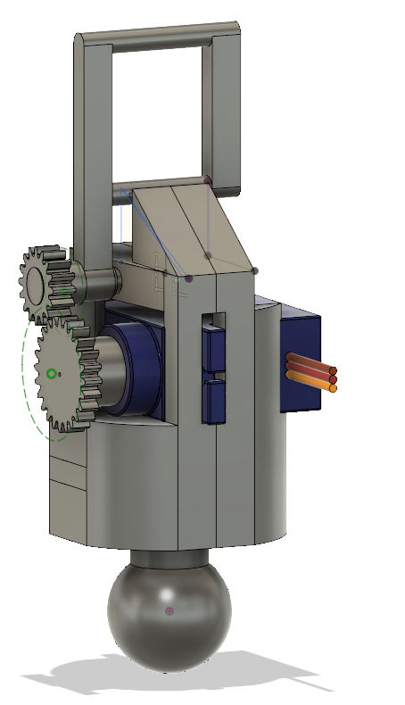
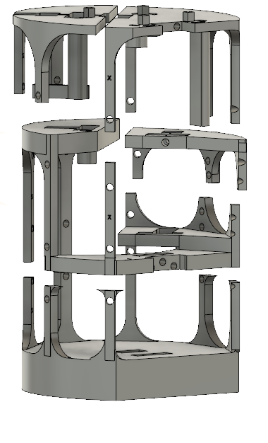
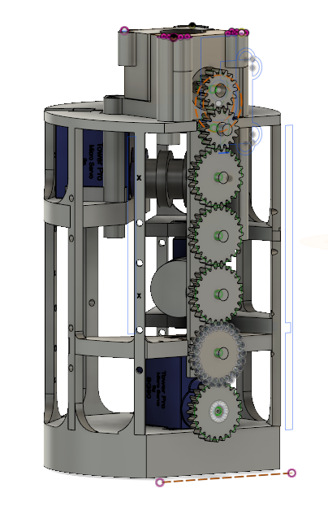
Progression of Design up until CDR

Slide 5
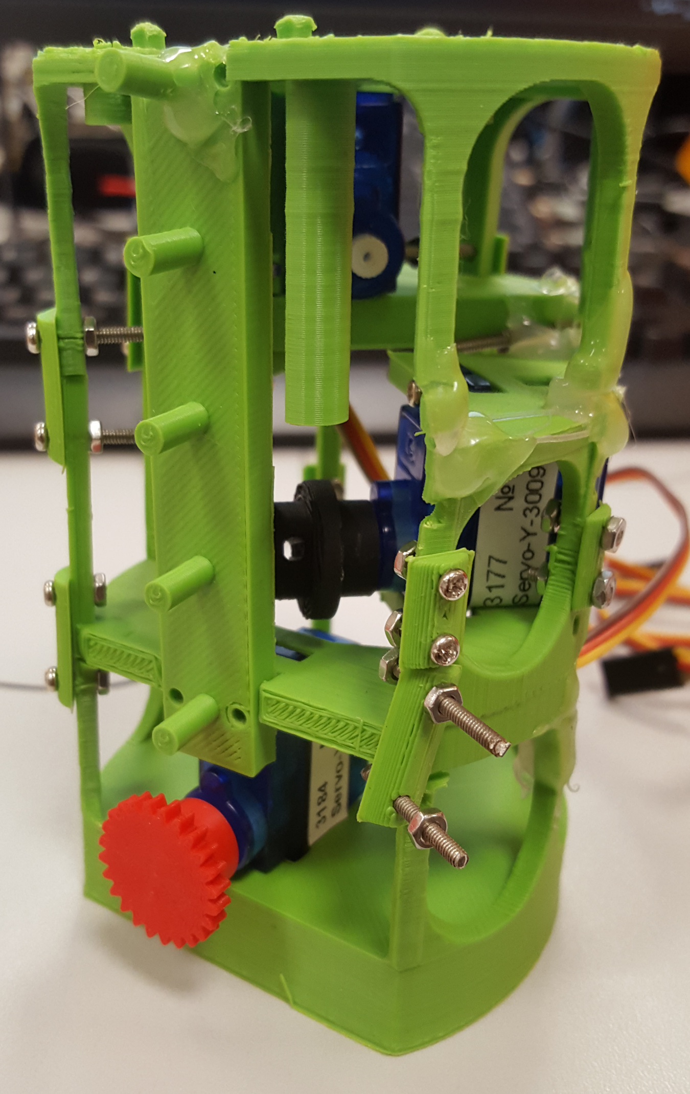
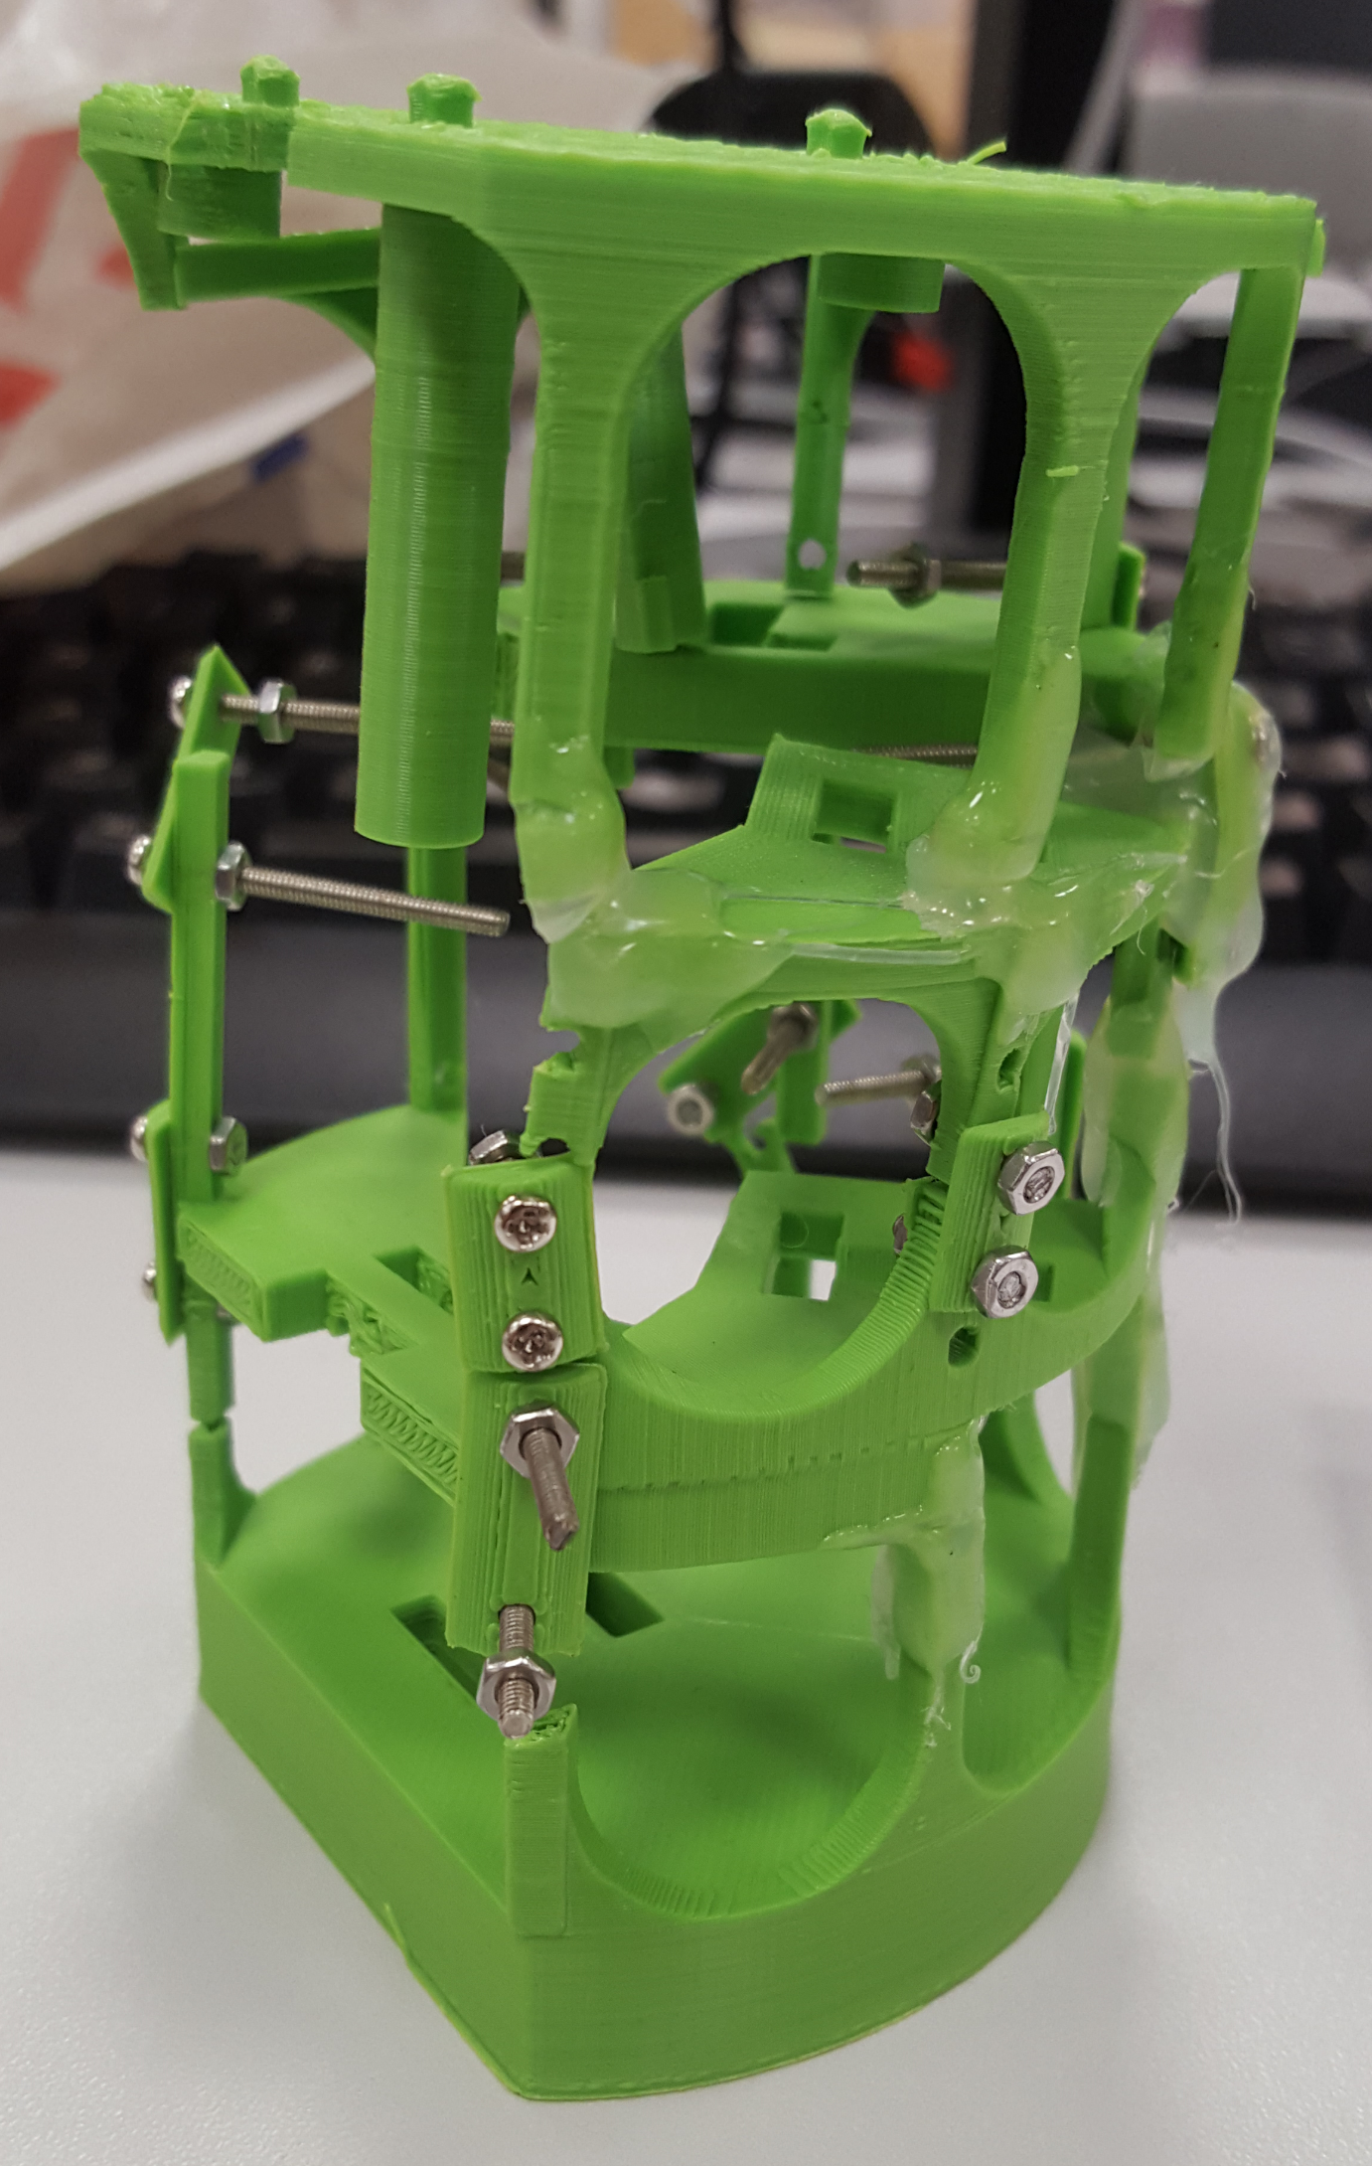
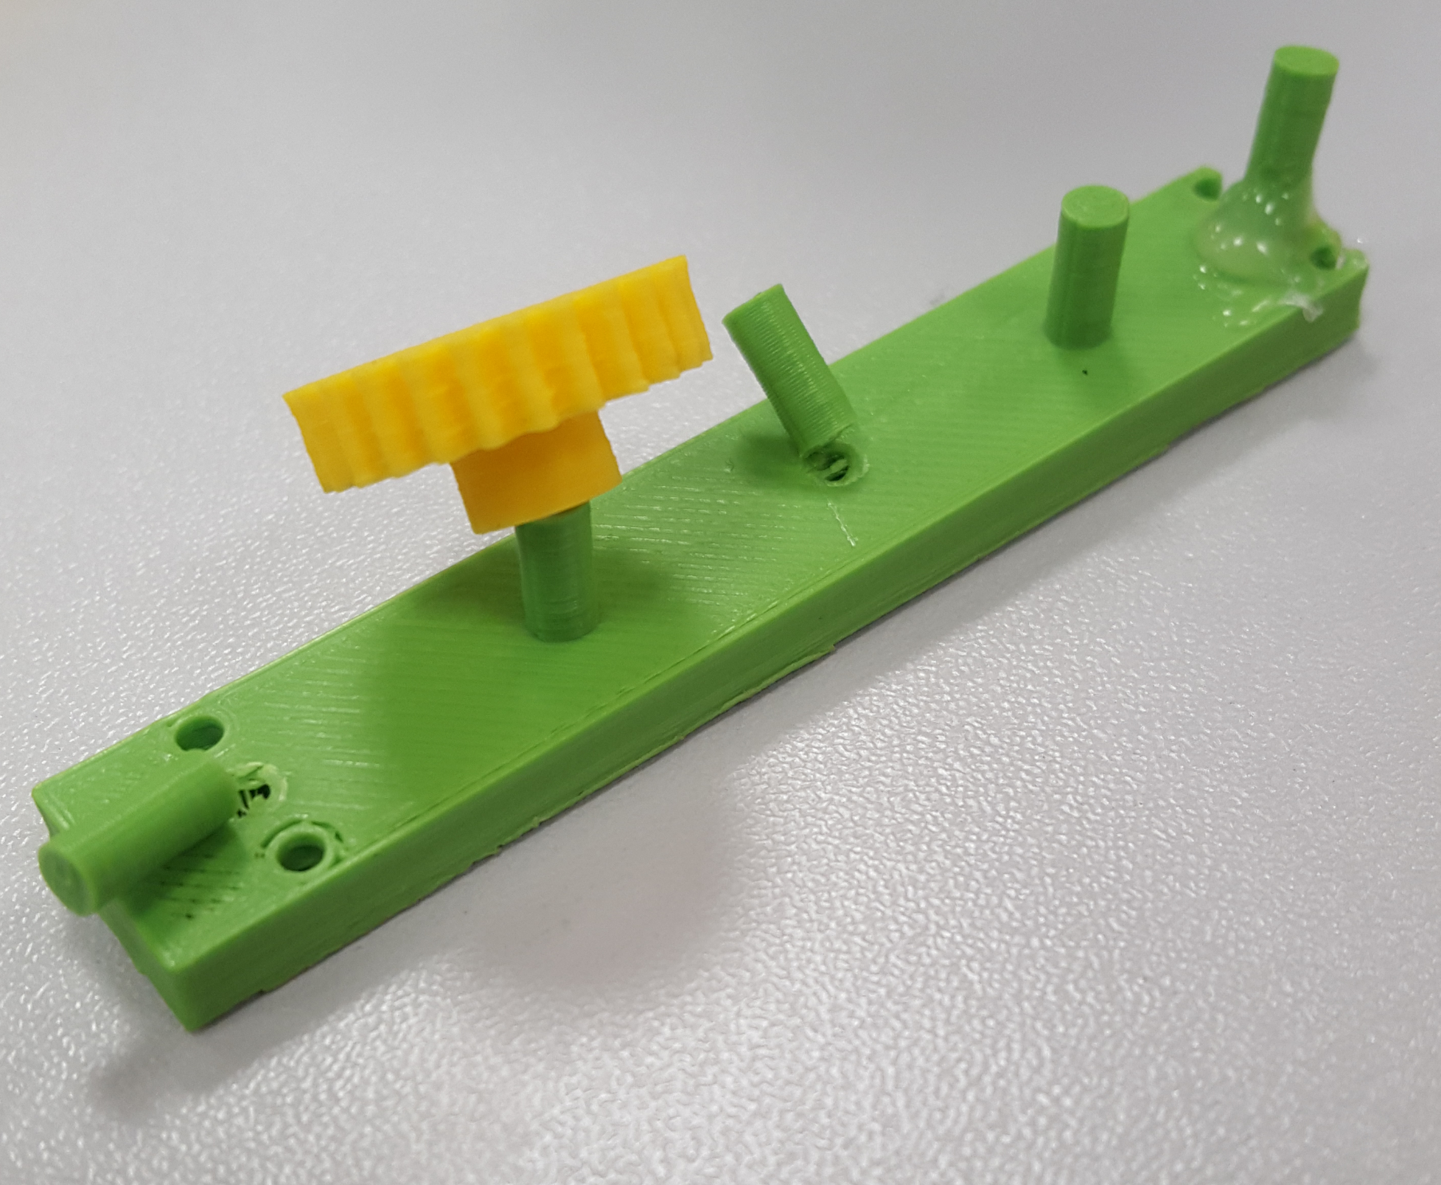
Issues found with CDR Designs

Slide 6
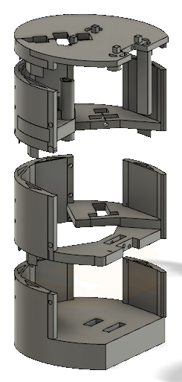
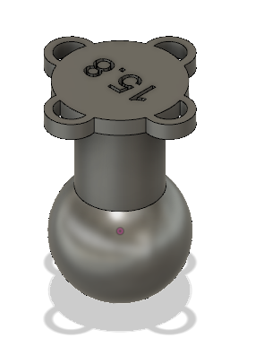
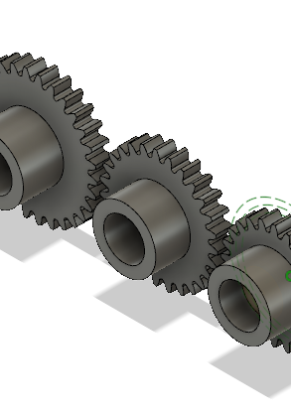
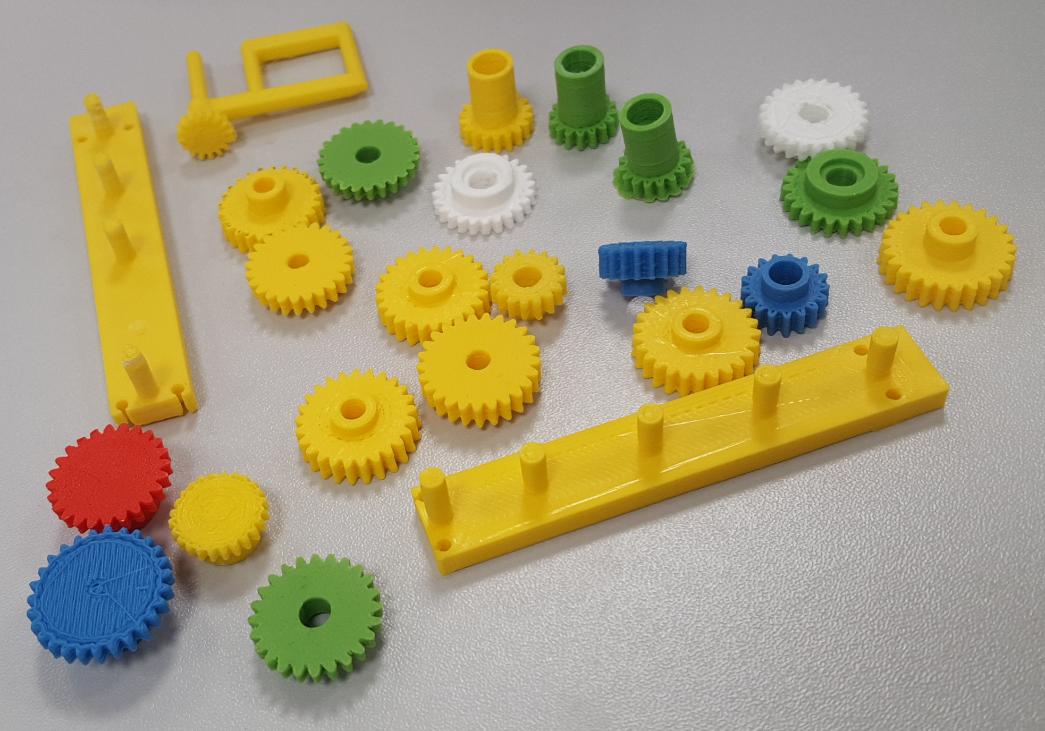
Redesigns Since CDR

Slide 7
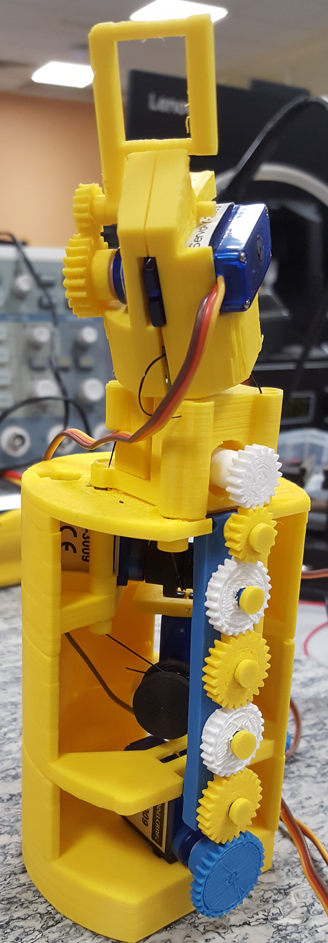
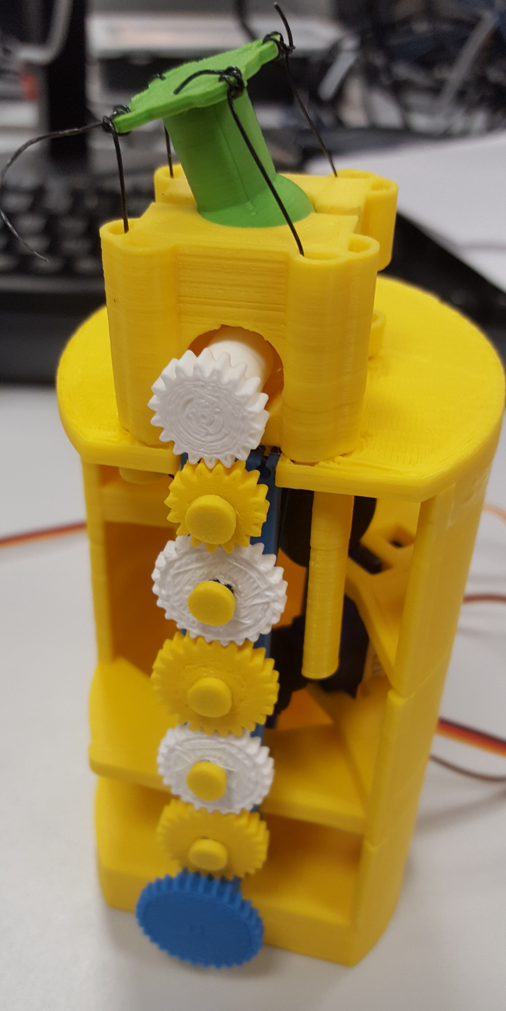
Final Design

Slide 8
Condolensces
A huge thank you to Matin Stoelen for providing such an excellent and enjoyable module and of course to Jake Gibson Shaw-Sutton for the constant support with our design and the massive patience it must have taken whilst dealing with our regular pestering.

